Slide 1

BAN610 – Database Management & Applications (Term Paper)
Presented By : Group 1
Aakar Kale
Arjav Kala
Mansi Shah
Shruti Bhalotiya
Vibhuti Vadje

Slide 2
Business Rules and Assumptions
1. Students in the database can be domestic or international.
2. Student will have exactly one major.
3. One major can have one or more courses.
4. Each course can be a part of one or more major.
5. Each course must have at least one student.
6. A student can enroll into one or more courses.
7. Each course can be taught by one or more professors.
8. For each course, instructor can recommend one or more books. Book publisher for each book must be stored.

Slide 3
Business Rules and Assumptions
9. A major can have one or more instructors.
10. An instructor can be a part of one or more majors.
11. Total fees of both domestic and international student must be stored.
12. Database will also track the fees paid, total outstanding amount and penalties in the student account table.
13. Visa status of students will also be stored.
14. Each course will have mandatory credit hours.
15. Grades of each course will be stored for all students.

Slide 4
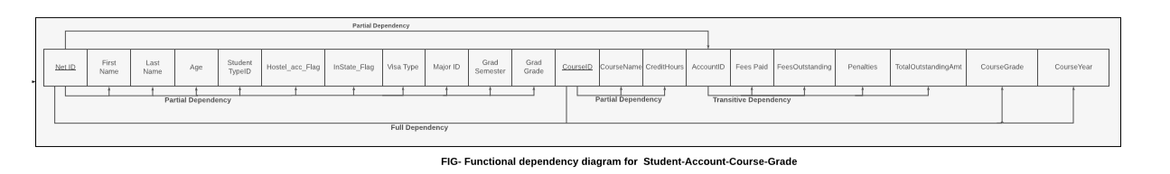
Functional Dependency diagram (Student -Account -Course-Grade)

Slide 5
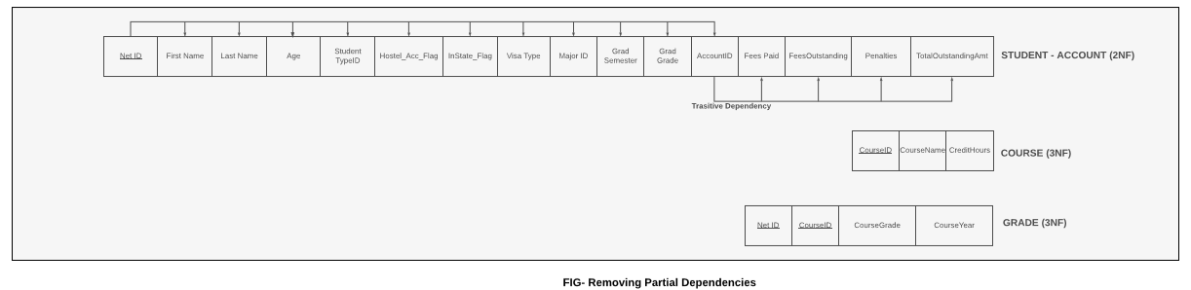
Functional Dependency diagram (Student -Account -Course-Grade)

Slide 6
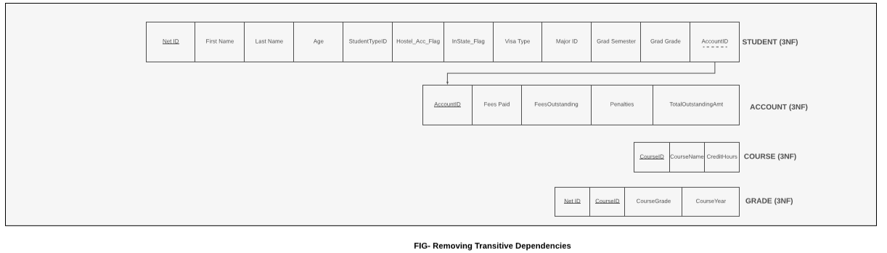
Functional Dependency diagram (Student -Account -Course-Grade)

Slide 7
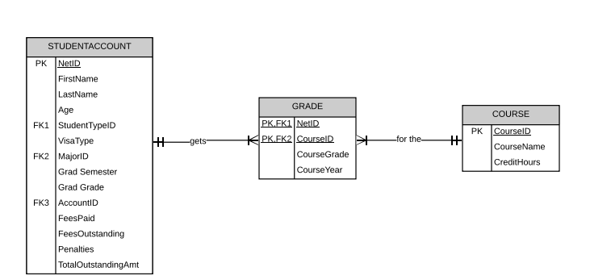
Relational Model
(Student -Account -Course-Grade)
FIG : Relational Model for StudentAccount-Grade-Course (2NF)

Slide 8
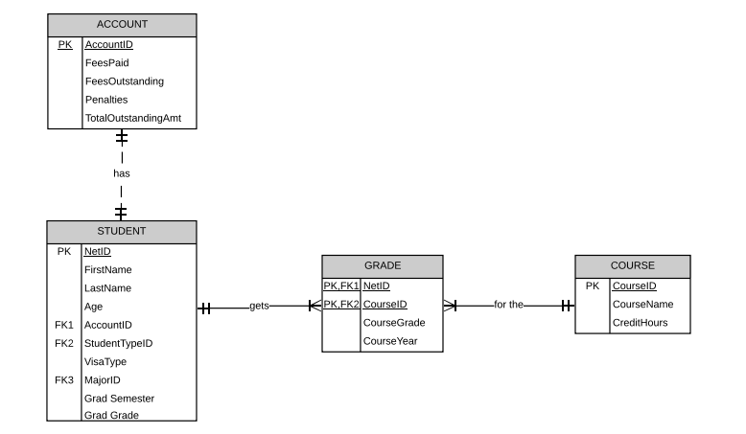
Relational Model
(Student -Account -Course-Grade)
FIG : Relational Model for Student-Account-Grade-Course (3NF)

Slide 9
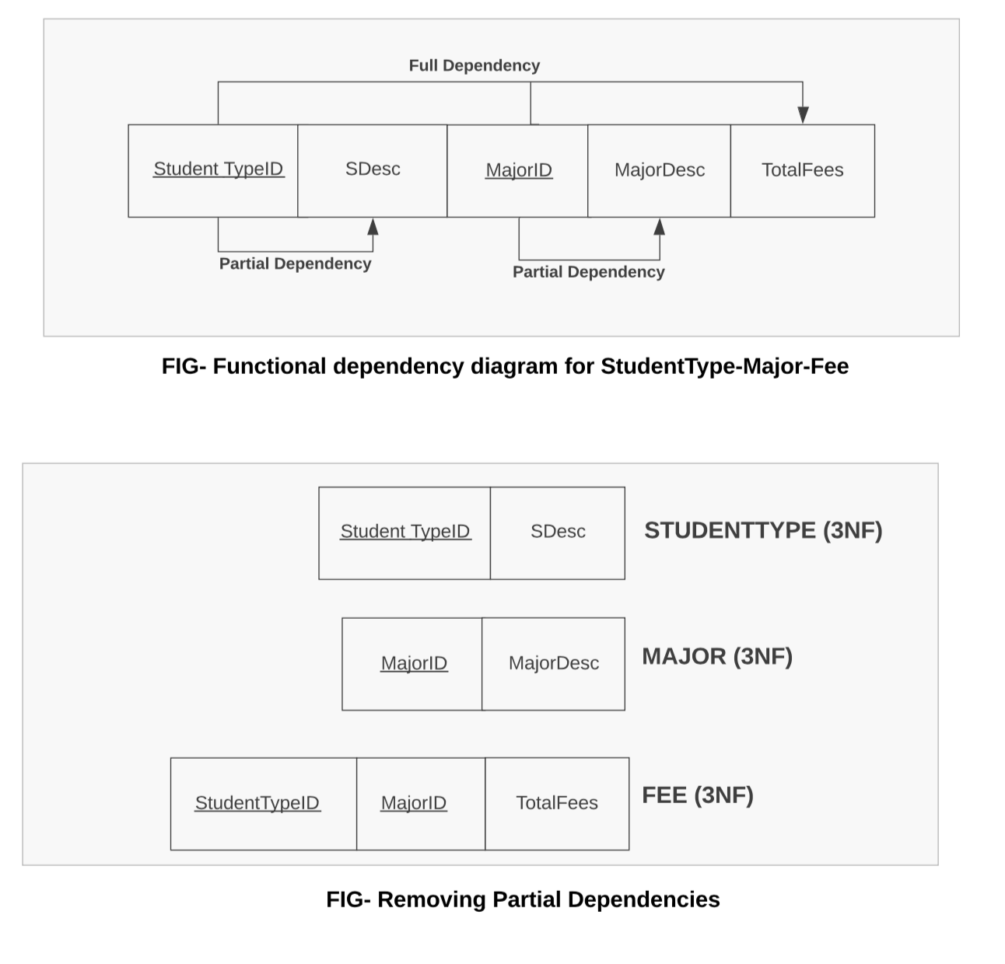
Functional Dependency diagram (StudentType -Major-Fee)

Slide 10
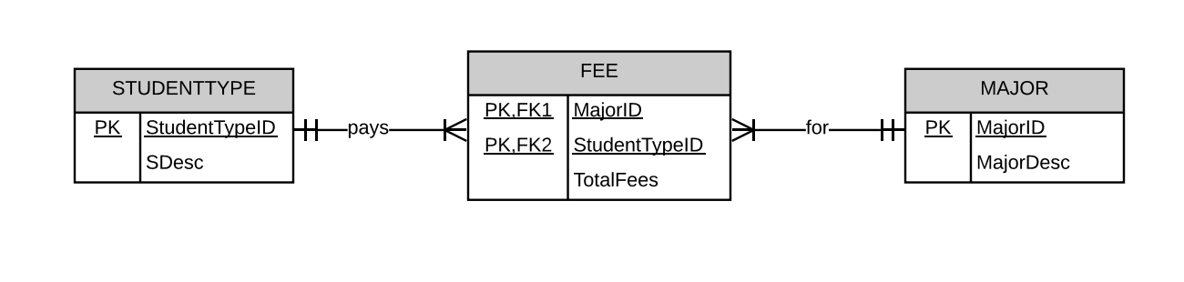
Relational Model
(StudentType-Major-Fee)
FIG : Relational Model for StudentType-Major-Fee (3NF)

Slide 11
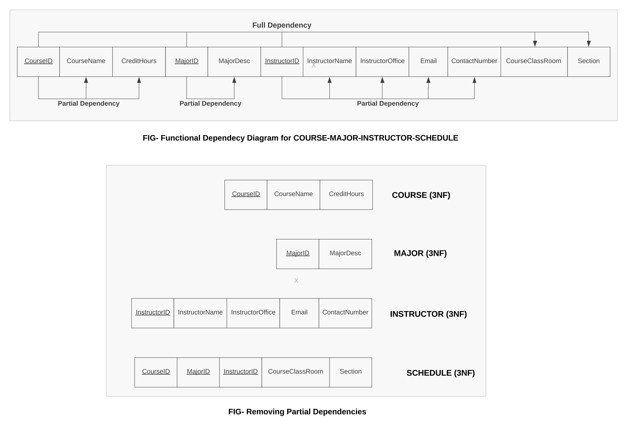
Functional Dependency diagram (Course-Major-Instructor-Schedule)

Slide 12
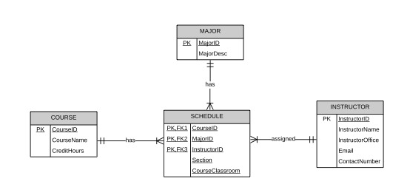
Relational Model
(Course-Major-Instructor-Schedule)
FIG : Relational Model for Course-Major-Instructor-Schedule (3NF)

Slide 13
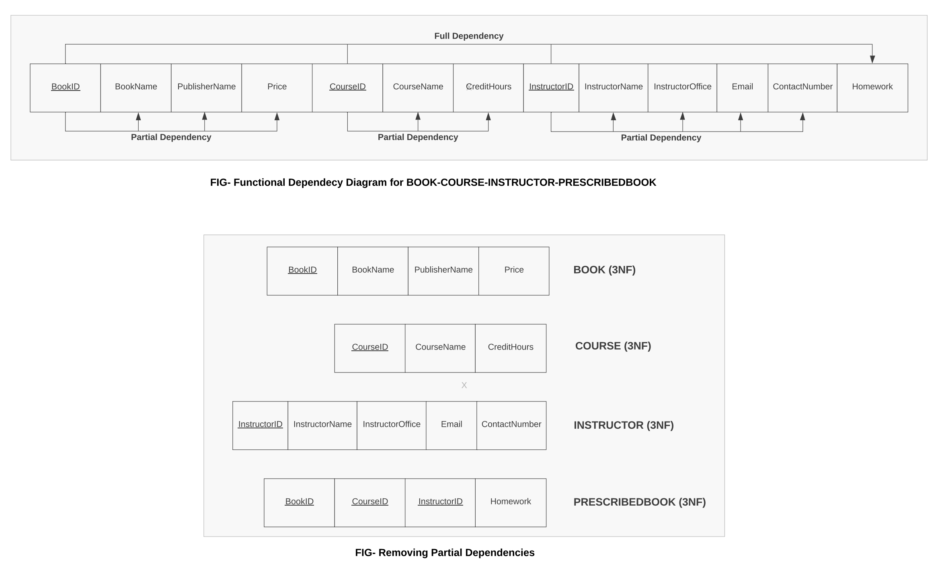
Functional Dependency diagram (Book-Course-Instructor-PrescribedBook)

Slide 14
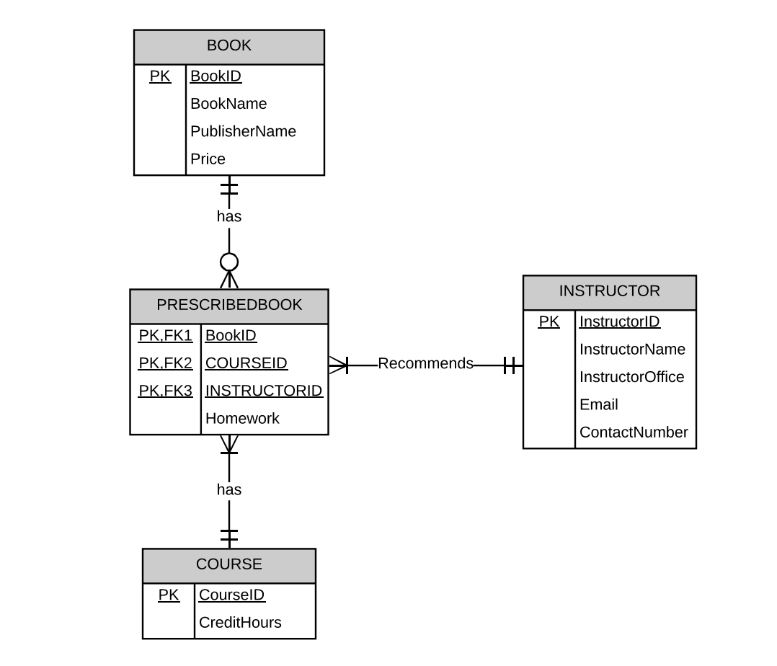
Relational Model
(Book-Course-Instructor-PrescribedBook)
FIG : Relational Model for Book-Course-Instructor-PrescribedBook (3NF)

Slide 15
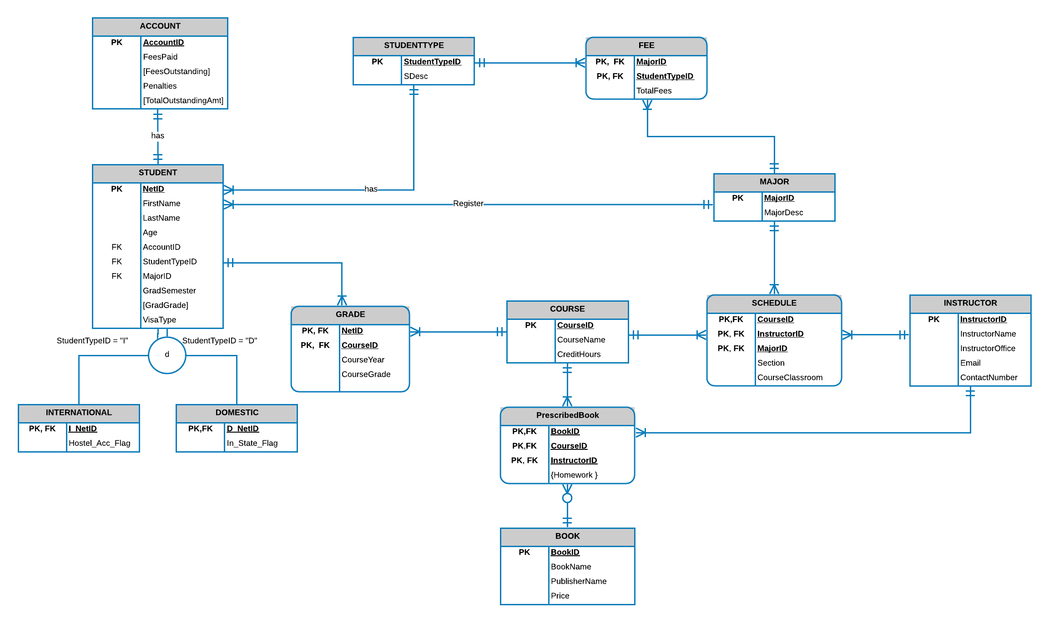
Entity Relationship Diagram

Slide 16
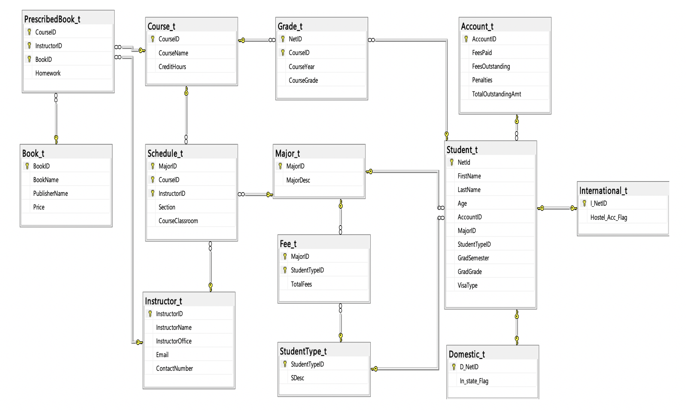
Database Diagram

Slide 17
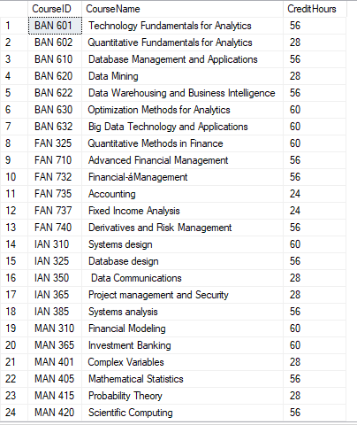
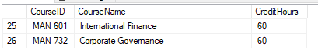
Content Screenshot – Course_t

Slide 18
Content Screenshot – Instructor_t

Slide 19
Content Screenshot – Book_t

Slide 20
Content Screenshot – Major_t

Slide 21
Content Screenshot – StudentType_t

Slide 22
Content Screenshot – Fee_t

Slide 23
Content Screenshot – Account_t

Slide 24
Content Screenshot – Student_t

Slide 25
Content Screenshot – International_t

Slide 26
Content Screenshot – Domestic_t

Slide 27
Content Screenshot – Grade_t

Slide 28
Content Screenshot – Schedule_t

Slide 29
Content Screenshot – Prescribed_t

Slide 30
Test Query 1: Count the number of students who are graduating in the same semester
Query :
Select GradSemester 'Graduation Semester',count(NetID) as "Number of Students"
from Student_t
group by GradSemester
Output:

Slide 31
Test Query 2: Display the students name and major who have taken BAN 610
Query :
Select s.FirstName+' '+s.Lastname 'Student Name', m.MajorDesc Major
from Student_t s, Major_t m, Grade_t g
where s.NetId = g.NetID and s.MajorID = m.MajorID and g.CourseID = 'BAN 610'
Output :

Slide 32
Test Query 3: Display the NetID and student name of the students who have taken more than
8 courses in year 2018
Query :
Select s.NetId,s.FirstName+' '+s.Lastname 'Student Name'
from Student_t s
where s.NetId in (select NetID from Grade_t
where CourseYear like '%2018'
group by NetID
having count(CourseID)>8)
Output :

Slide 33
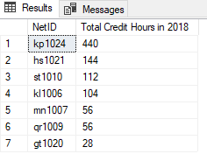
Test Query 4: Display the NetID and the total credit hours taken by each student in 2018
Query :
select g.NetID, sum(c.CreditHours) 'Total Credit Hours in 2018'
from Grade_t g, Course_t c
where g.CourseID = c.CourseID and g.CourseYear like '%2018'
group by g.NetID
order by 'Total Credit Hours in 2018' desc
Output :

Slide 34
Test Query 5: Display the instructors name and the number of course books prescribed by
each instructor
Query :
select I.InstructorName, count(distinct P.BookID) "Number of books prescribed"
from Instructor_t I, PrescribedBook_t P
where I.InstructorID = P.InstructorID
group by I.InstructorName
order by count(distinct P.BookID) desc
Output :

Slide 35

Questions?

Slide 36
Thank You!!

